Slide 1

Secret Calculator
by Fivetran
Iteration 3 - December 4, 2019
Kyra Belgica
Hamilton Nguyen
Marvin Wellington

Slide 2
Agenda
Project Description
Requirements
High Level Use Cases
Use Case Diagram
Requirements Use Case Traceability Matrix
Increment Matrix
Expanded Use Case/UI Prototypes
Domain Model Diagram
Sequence Diagram
Design Class Diagram
App Demo
Q&A

Slide 3







Project Description
Fully functional basic calculator with a hidden app.
Performs basic operations(addition, subtraction, division, and multiplication) on all real numbers.
user will be prompted to create a four-digit numerical code within a GUI window.
To access the hidden app the user will enter in their passcode followed by “%”.
Option to store pictures and text files.
Users can store multiple passwords to multiple accounts.
Timeout after 10 seconds of inactivity (return to calculator activity).

Slide 4

Requirements
# | Src | Functional Requirements
R1 | 3 | The app shall allow the user to perform the four basic functions of a calculator (addition, subtraction, multiplication, and division).
R2 | 5 | The app shall allow the user to clear, perform percentage arithmetic operations, and input negative numbers.
R3 | 6 | The app shall allow the user to enter their personalized passcode upon opening the "spectre" screen. First time access only.
R4 | 14 | The app shall allow the user to reset the calculator factory setting with the input "0000%"
R5 | 9 | The app shall bring the user to a storage section in "spectre" screen upon entering the passcode followed by "%" sign.
R6 | 10 | The app shall allow the user to store images files via camera or upload. jpeg file only.
R7 | 10 | The app shall allow the user to store credential information such as domain, username and password within the app.
R8 | 12 | The app shall allow the user to store text files .txt format only.
R9 | 11 | The app shall allow the user to view the stored domain names, usernames,and passwords upon request.
R10 | 12 | The spectre screen shall timeout and return to the calculator screen after 10 seconds of inactivity.
R11 | 17 | The files uploaded to the app shall be stored on the phone's external secure digital card.

Slide 5
Requirements Cont.
# | Src | Functional Requirements
R12 | 17 | The files shall be encrypted when not viewed. (AES, SHA-256)
R13 | 18 | The files shall be decrypted before viewing. (AES, SHA-256)
R14 | 19 | The files uploaded to the app shall be opened by the phone's default apps (e.g. .jpegs will be opened with the phone's Gallery app).
Non-Functional Requirements
R15 | 20 | The app shall support the minimum of Android 4.x or higher.
R16 | 34 | The app shall be developed using Android Studio 3.0.
R17 | 36 | The app will be developed using a reference textbook name Android Studio 3.0 Essentials.
Interface Requirements
R18 | 3 | The app's calculator interface shall be the same GUI as a regular android calculator.
R19 | 29 | The app's storage interface shall allow the user to view files by all or by type.

Slide 6
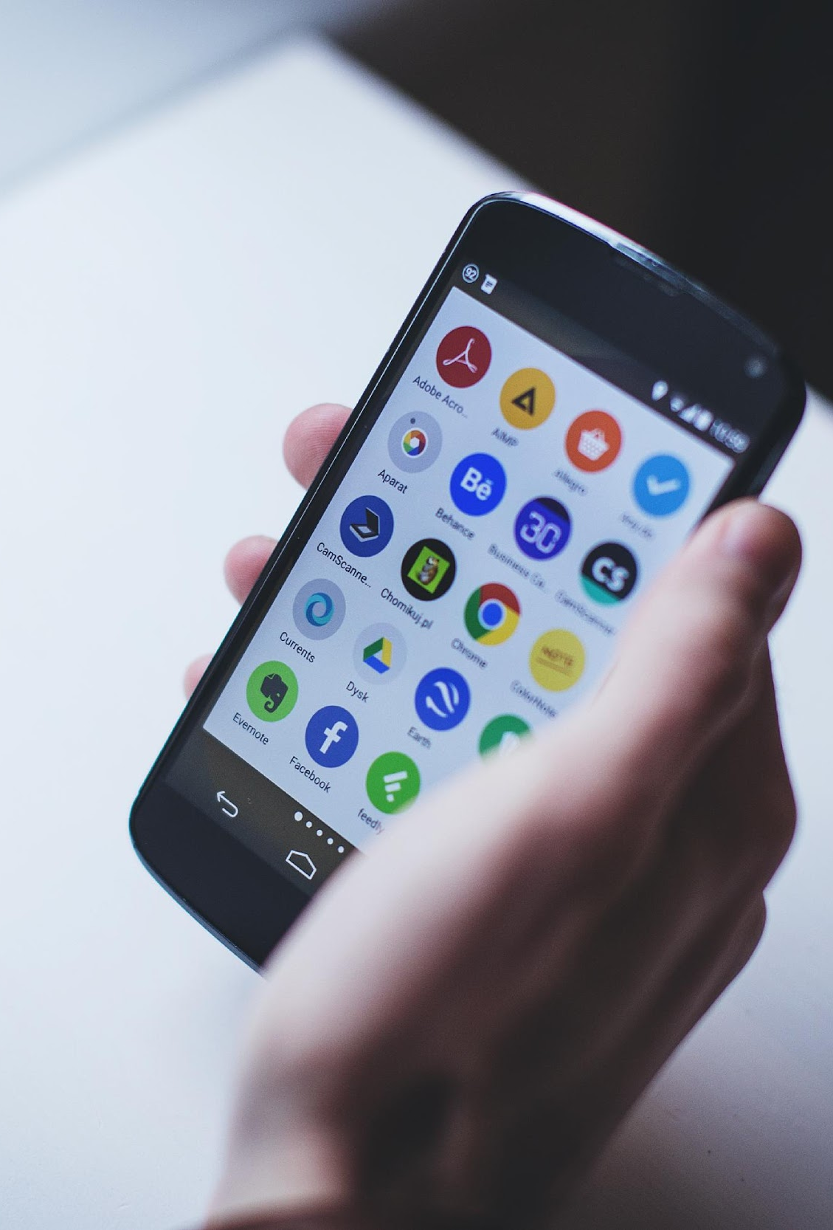
High Level Use Cases
UC 1: Open the Secret Calculator app.
-TUCBW the user clicked on the app icon “Calculator” through an android phone.
-TUCEW the user will enter a four numerical lock code into the prompt. Upon completion, the app will automatically store the four numerical lock code and display to the calculator screen.
UC 2: Secret Calculator basic operations.
-TUCBW the user clicked on the app icon “Calculator” through an android phone.
-TUCEW the user completes basic operations by inputting it exactly in this syntax e.g. ((integer)(arithmetic operator)(integer)) and received an output. The user can also input AC, negative numbers, and percentage operation.
UC 2.1: Secret Calculator addition operation.
-TUCBW the user performed basic addition operation (e.g. 2+2) by inputting in the calculator.
-TUCEW the user received a calculated output in the output screen.
UC 2.2: Secret Calculator subtraction operation.
-TUCBW the user performed basic subtraction operation (e.g. 2-2) by inputting in the calculator.
-TUCEW the user received a calculated output in the output screen.
UC 2.3: Secret Calculator multiplication operation.
-TUCBW the user performed basic multiplication operation (e.g. 2*2) by inputting in the calculator without unexpected fail execution.
-TUCEW the user received a calculated output in the output screen.

Slide 7
High Level Use Cases Cont.
UC 2.4: Secret Calculator division operation.
-TUCBW the user performed basic division operation (e.g. 2/2) by inputting in the calculator without unexpected fail execution.
-TUCEW the user received a calculated output in the output screen.
UC 3: Opening the hidden interface GUI “Spectre Screen”.
-TUCBW the user will enter the four numerical lock code through the calculator GUI keypad followed by the “%” sign. (e.g. 1234%)
-TUCEW the app will accept the code, then it will display to the hidden interface GUI “Spectre Screen”. After 10 seconds of inactivity, the spectre screen will return to the calculator screen.
UC 4: Store Pics file in the hidden Interface GUI “Spectre Screen”.
-TUCBW the user clicked on “Store Pics” button, the app will prompt a dialog box, and the user will click on the media files to upload (e.g. .jpeg files).
-TUCEW the app displaying a dialog box "upload complete” and will store the file on the device.
UC 4.1: Store Documents file in the hidden Interface GUI “Spectre Screen”.
-TUCBW the user clicked on “Store Documents” button, the app will prompt a dialog box, and the user will click on the media files to upload (e.g. .txt files).
-TUCEW the app displaying a dialog box "upload complete” and will store the files on the device.

Slide 8
High Level Use Cases Cont.
UC 4.2: Delete media file in the hidden Interface GUI “Spectre Screen”.
-TUCBW the user clicked on “delete” button, the app will prompt a dialog box, and the user will click on the media file to delete (e.g. .txt and .jpeg files).
-TUCEW the app displaying a dialog box "delete complete”.
UC 4.3: Open media file in the hidden Interface GUI “Spectre Screen”.
-TUCBW the user clicked on “open” button, the app will prompt a dialog box, and the user will click on the media file to open and execute it with a default application to open file. (e.g. .jpeg files open by a phone’s photo gallery app).
-TUCEW the user hitting the back button once on the android phone and will navigate back to “Spectre” screen.
UC 4.4: Storing domain, username and password in the hidden Interface GUI “Spectre Screen”.
-TUCBW the user entering the domain, username and password to store in the GUI “spectre Screen”. After entering, the user will click save button on the app.
-TUCEW the app accepting the input from the user and saving it in the app.
UC 4.5: View credentials in the hidden Interface GUI “Spectre Screen”.
-TUCBW the user click on the button View Credentials in the spectre Screen.
-TUCEW the app accepts the input from the user and view the domain, username, and password to the user.

Slide 9
High Level Use Cases Cont.
UC 4.6: reset “Spectre” screen
-TUCBW the user clicked on “reset” button, the app will prompt a dialog box, the user will click accept and all media files will delete from the hidden storage.
- TUCEW the app displaying a dialog box "reset complete”.
UC 5: Resetting to original calculator app in the calculator screen.
-TUCBW the user will enter “0000+” through a calculator numerical keypad. The app will prompt a display to the user, the user will either click agree or disagree and then the app execute the user input.
-TUCEW the app will delete all media files stored in the calculator, and reset to the original distributed version of the android app.

Slide 10
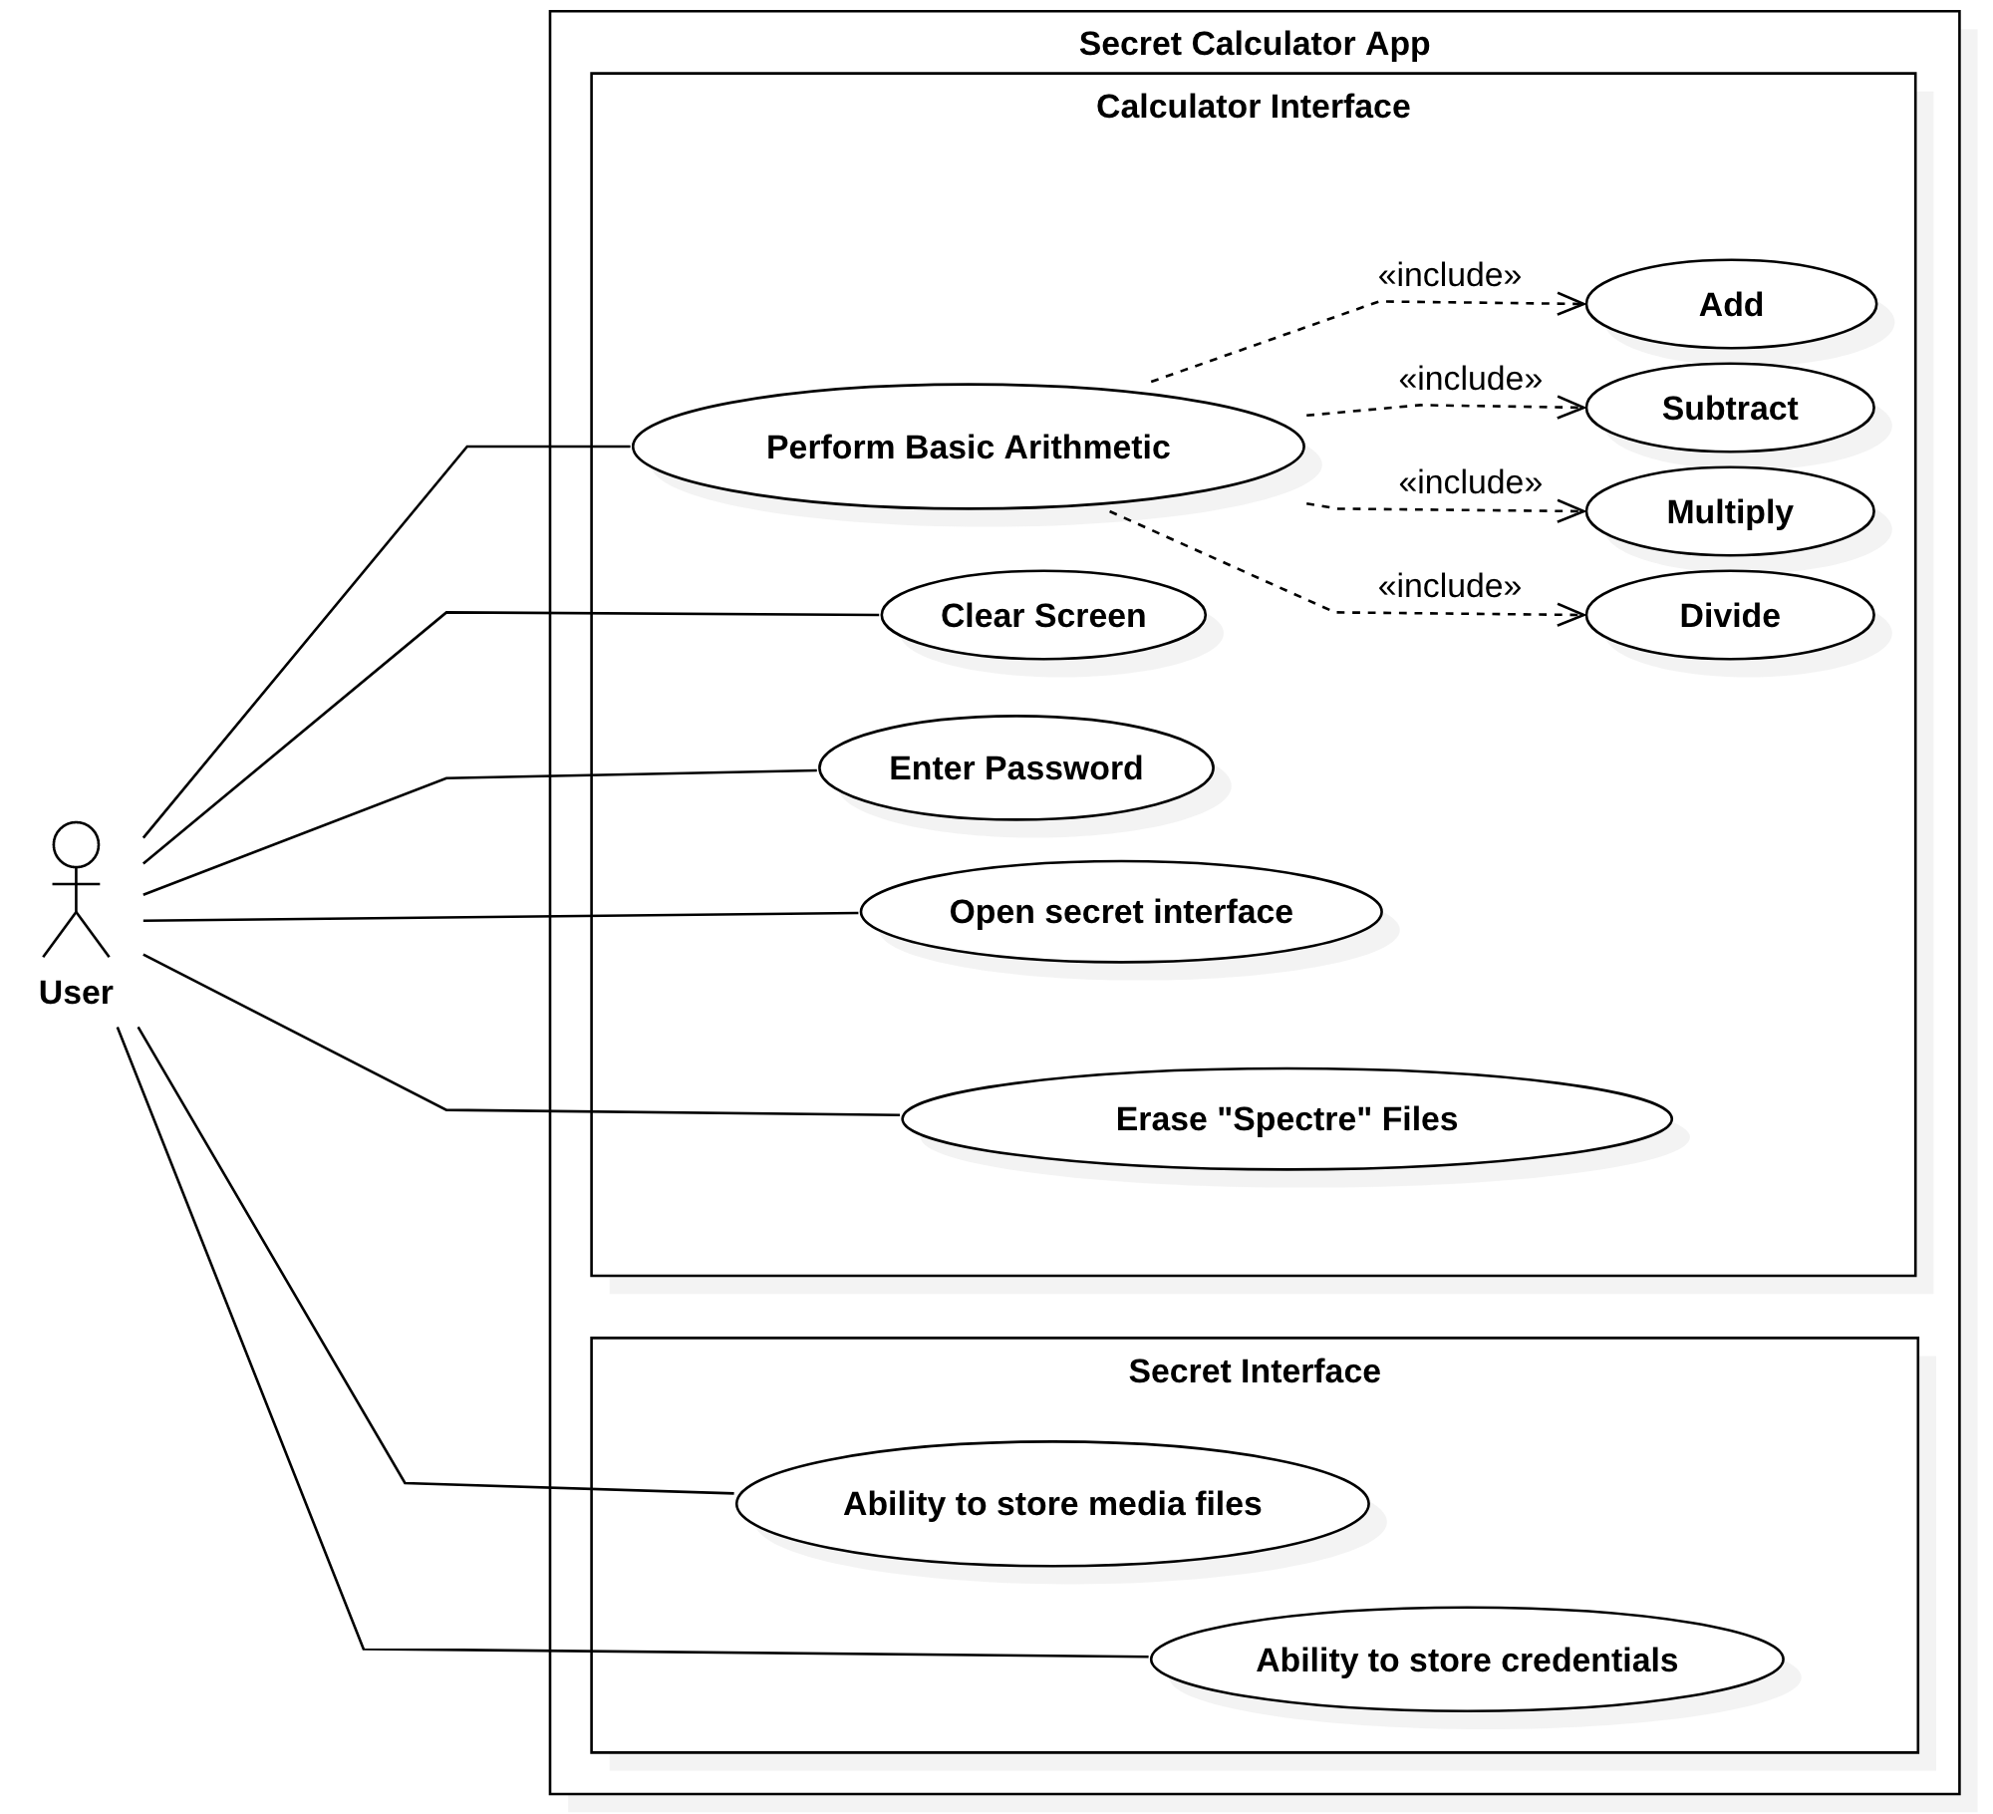
Use Case Diagram

Slide 11
Requirements to Use Case Traceability Matrix
 | Priority Weight | All UC | UC1 | UC 2, 2.1-2.4 | UC 3 | UC 4, 4.1-4.5 | UC 5
R1 | 4 | x |  | x
R2 | 4 | x |  | x
R3 | 3 | x | x
R4 | 3 | x |  |  |  |  | x
R5 | 2 | x |  |  |  | x
R6 | 2 | x |  |  |  | x
R7 | 2 | x |  |  |  | x
R8 | 2 | x |  |  |  | x
R9 | 3 | x |  |  |  | x
R10 | 3 | x |  |  | x
R11 | 4 | x |  |  |  | x
R12 | 4 | x |  |  |  | x
R13 | 4 | x | x
R14 | 4 | x |  |  |  | x
R15 | 3 | x | x
R16 | 2 | x | x
R17 | 2 | x | x
R18 | 2 | x | x
R19 | 2 | x | x |  |  |  | x
SCORE |  | 53 | 18 | 8 | 7 | 22 | 3
LEGEND SCORE: |  |  | PRIORITY WEIGHT:
HIGH NUMBER = HIGH PRIORITY TASKS |  |  | 1 = lowest priority
LOW NUMBER = LOW PRIORITY TASKS |  |  | 4 = highest priority

Slide 12
Increment Matrix
Use Case | Priority | Effort | Depends on | Increment 1 | Increment 2 | Increment 3
UC 1 | 18 | 2 | None | 2 | - | -
UC 2, 2.1-2.4 | 8 | 2 | UC 1 | 2 | - | -
UC 3 | 3 | 3 | UC 1 | - | 2 | 1
UC 4, 4.1-4.5 | 22 | 5 | UC 3 | - | 3 | 3
UC 5 | 3 | 3 | UC 3, 4, 4.1-4.5,5 | - | 1 | 2
Total Effort |  | 15 |  | 4 | 6 | 6

Slide 13
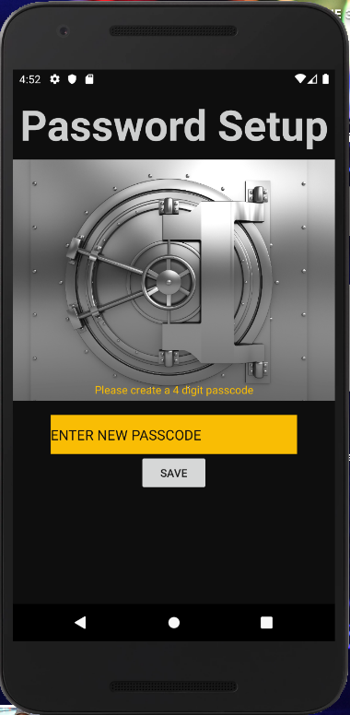
Secret Calculator App
Expanded Use Case
User Interface Prototypes

Slide 14
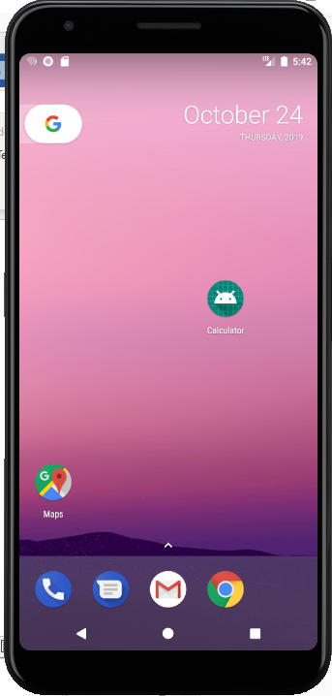
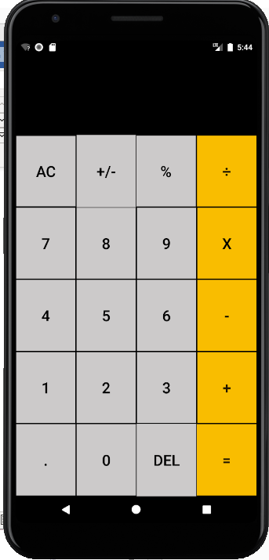
Expanded Use Case/User Interface Prototypes
Use Case 1: Open the Secret Calculator app.
Precondition: This use case assumes that the user has turned on the android phone unit and is on the home screen of the android phone.
Actor: User | System: Secret Calculator
TUCBW the user clicked on the app icon “Calculator” through an android phone. | 0. System displays the Secret calculator Icon.
2. The user will enter a four numerical lock code into the prompt. | 3. System will store the four numerical lock code.
 | 4. TUCEW the system display to the calculator screen.
Postcondition: The app is immediately available for arithmetic calculations and access to the hidden screen, “Spectre” screen.

Slide 15
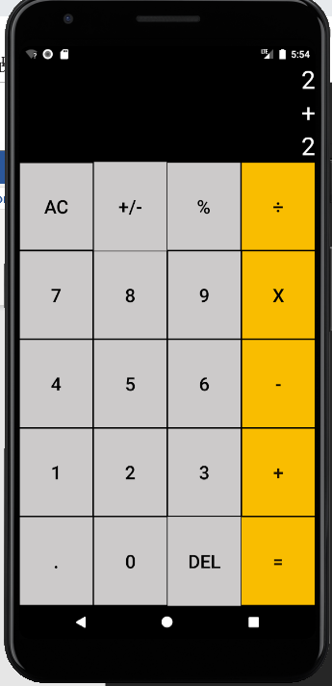
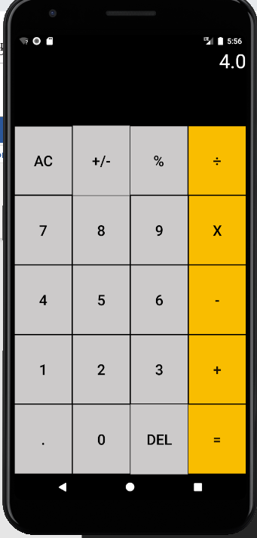
Expanded Use Case/User Interface Prototypes Cont.
Use Case 2.1: Secret Calculator addition operation.
Precondition: This use case assumes that the user has turned on the android phone unit, clicked on the app icon, and is on the calculator screen of the app.
Actor: User | System: Secret Calculator
1. TUCBW the user performed basic addition operation (e.g. 2+2) by inputting in the calculator. | *2. System accepts the input and perform arithmetic operation.
 | 3. TUCEW the system will display the output to the calculator screen.
Postcondition: The app is immediately available for another arithmetic calculations and have access to the hidden screen, “Spectre” screen.

Slide 16
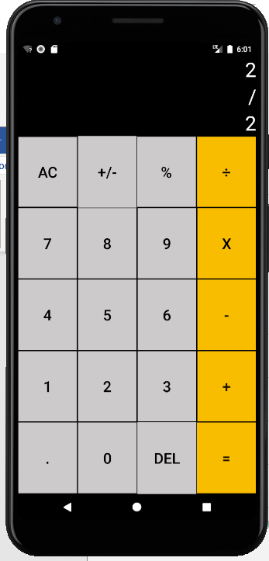
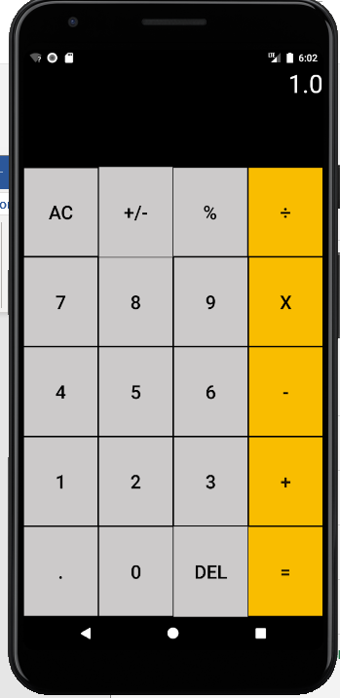
Expanded Use Case/User Interface Prototypes Cont.
Use Case 2.4: Secret Calculator division operation.
Precondition: This use case assumes that the user has turned on the android phone unit, clicked on the app icon, and is on the calculator screen of the app.
Actor: User | System: Secret Calculator
1. TUCBW the user performed basic division operation (e.g. 2/2) by inputting in the calculator. | *2. System accepts the input and perform basic arithmetic operations.
 | 3. TUCEW the system will display the output to the calculator screen.
Postcondition: The app is immediately available for another arithmetic calculations and have access to the hidden screen, “Spectre” screen.

Slide 17
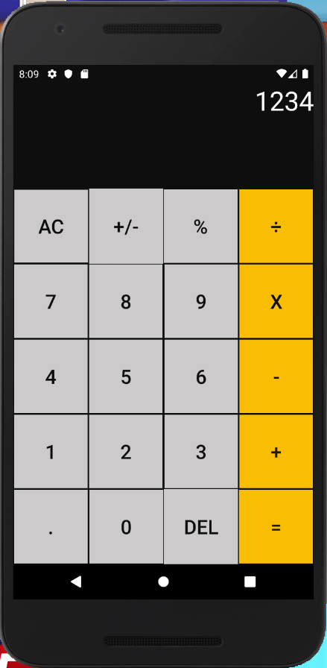
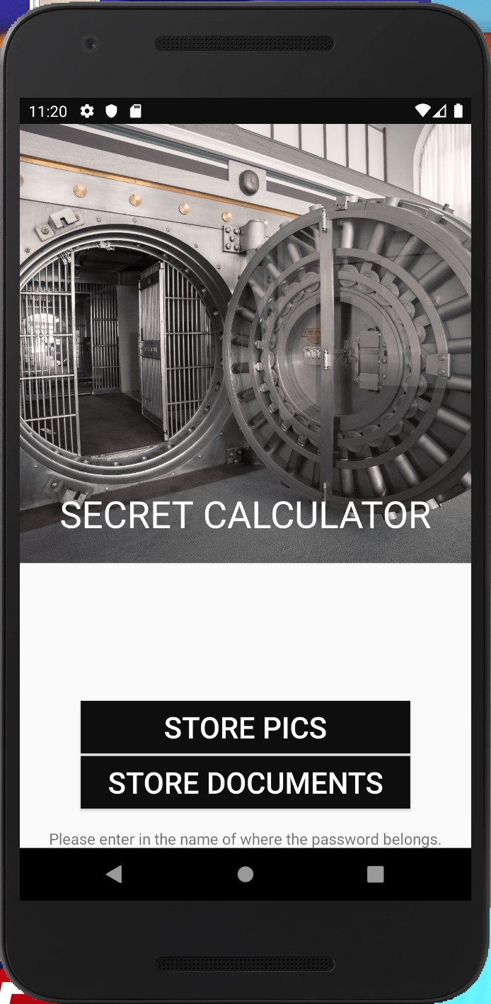
Expanded Use Case/User Interface Prototypes Cont.
Use Case 3: Opening the hidden interface GUI “Spectre Screen”
Precondition: This use case assumes that the user has turned on the android phone unit, clicked on the app icon, and is on the calculator screen of the app.
Actor: User | System: Secret Calculator
1. TUCBW the user will enter the four numerical lock code through calculator GUI keypad followed by the “%’ sign. (e.g. 1234%) | *2. System accepts the input and performed background processing.
 | 3. TUCEW the system will display the hidden interface GUI “Spectre Screen”
Postcondition: The app is immediately available for other operations inside the hidden screen, “Spectre” screen.

Slide 18
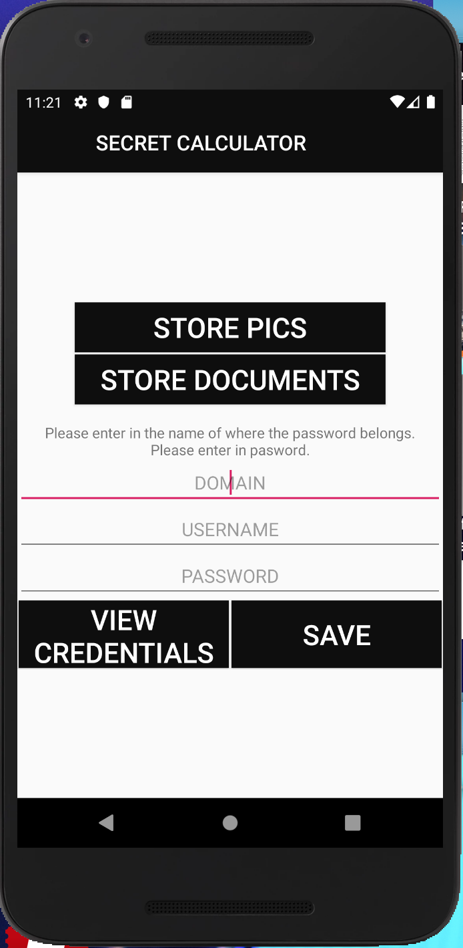
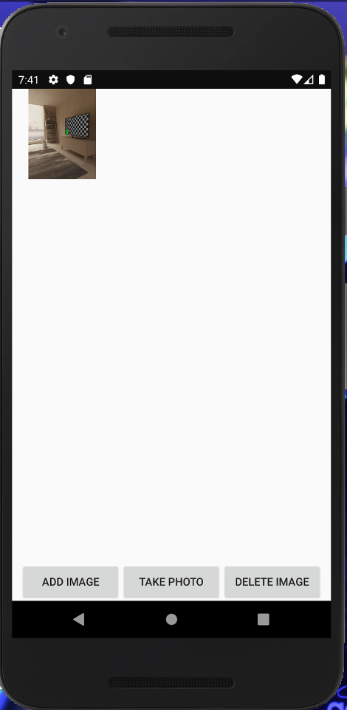
Expanded Use Case/User Interface Prototypes Cont.
Use Case 4: Store Pic file in the hidden Interface GUI “Spectre Screen”
Precondition: This use case assumes that the user has turned on the android phone unit, clicked on the app icon, and is on the “Spectre Screen” of the app.
Actor: User | System: Secret Calculator
1. TUCBW the user clicked on “Store Pics” button. | 2. System will prompt a dialog box.
3. the user will click on the media files to upload (e.g.jpeg files). | 4. TUCEW the system will accept and display the uploaded media file in a dialog box.
Postcondition: The app is immediately available for other operations inside the dialog box such as e.g. add image, take photo, delete image.

Slide 19
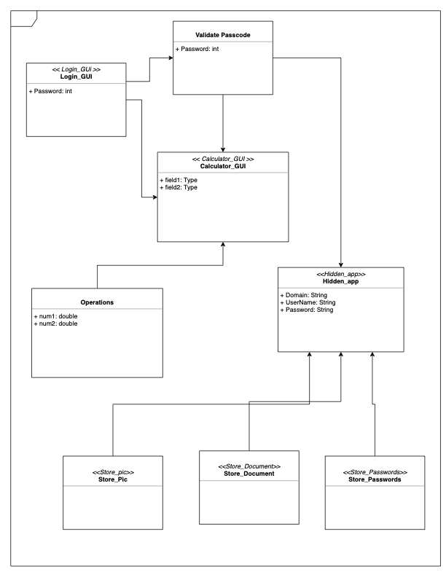
Domain Model

Slide 20
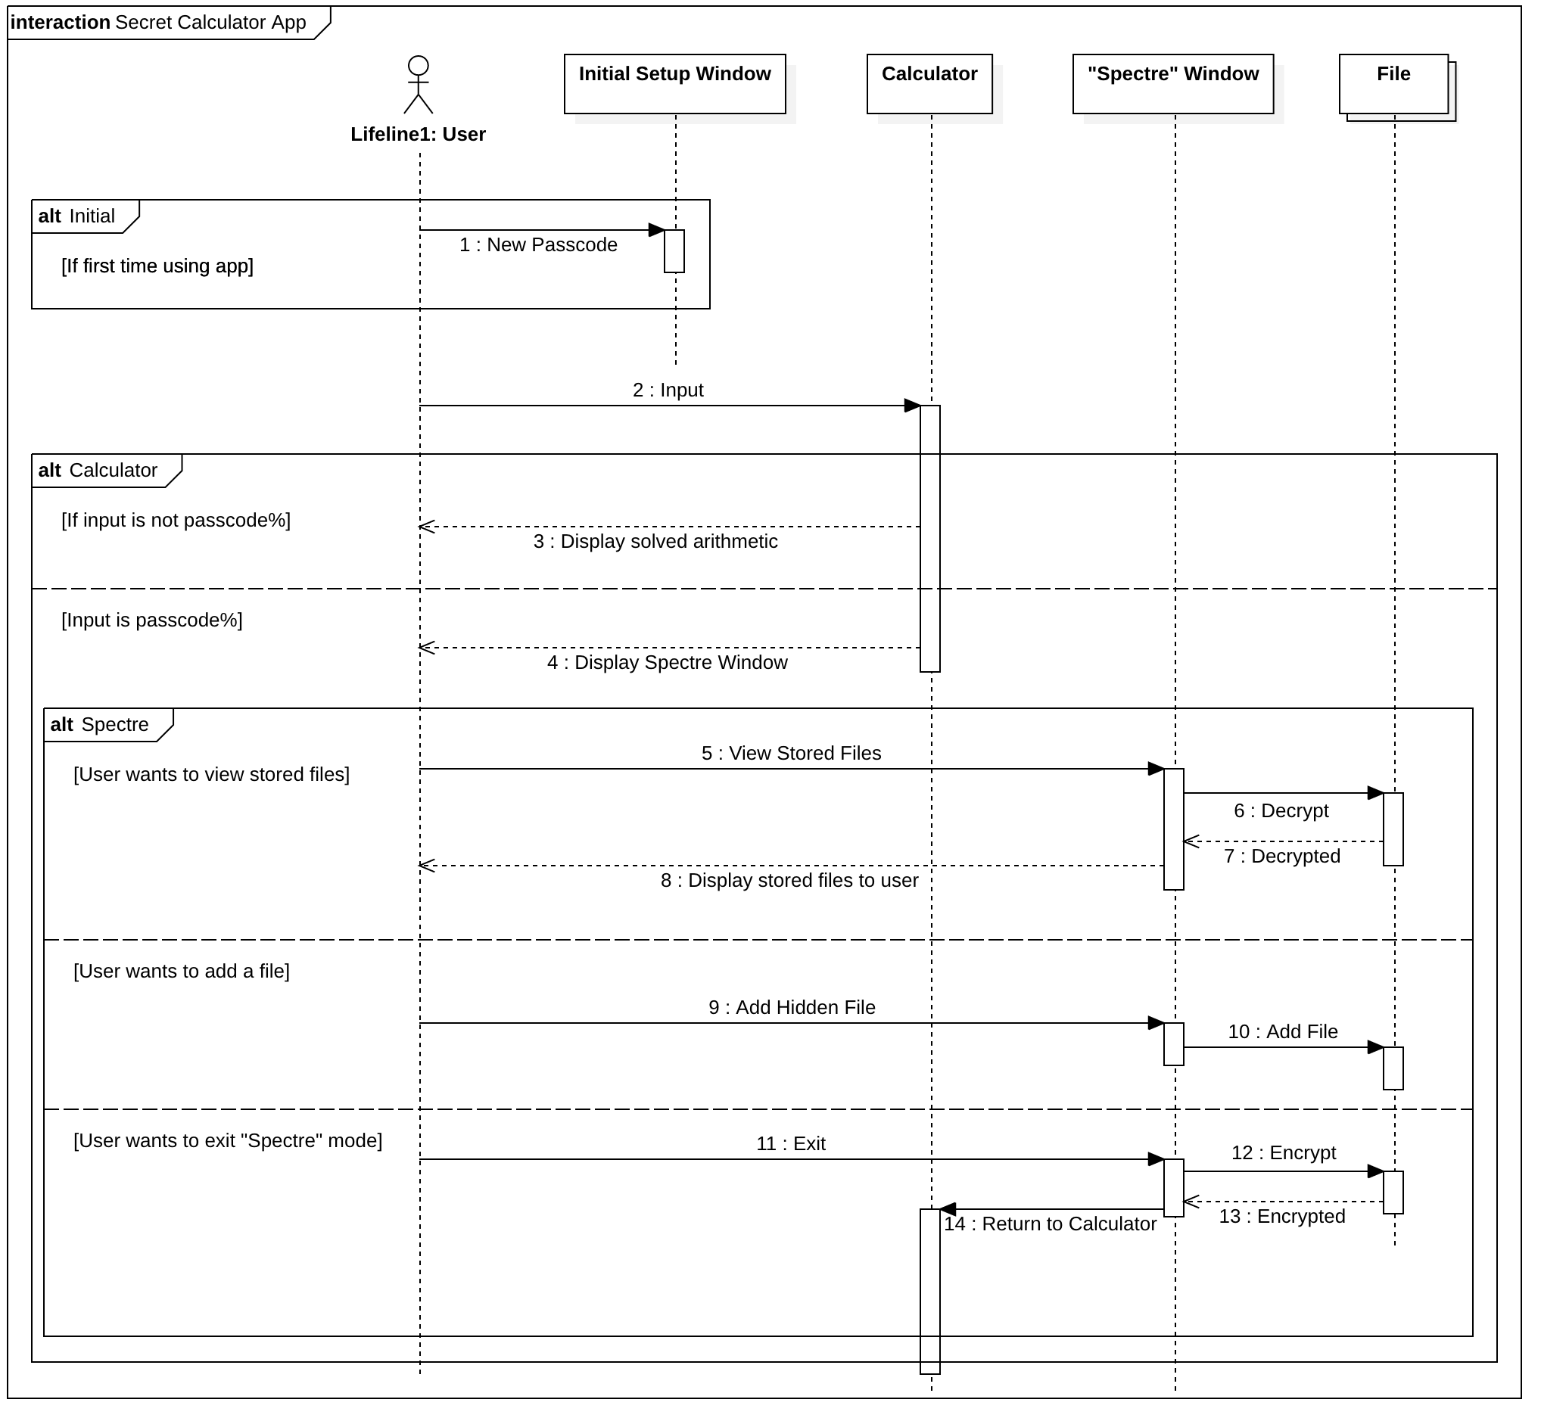
Sequence Diagram

Slide 21
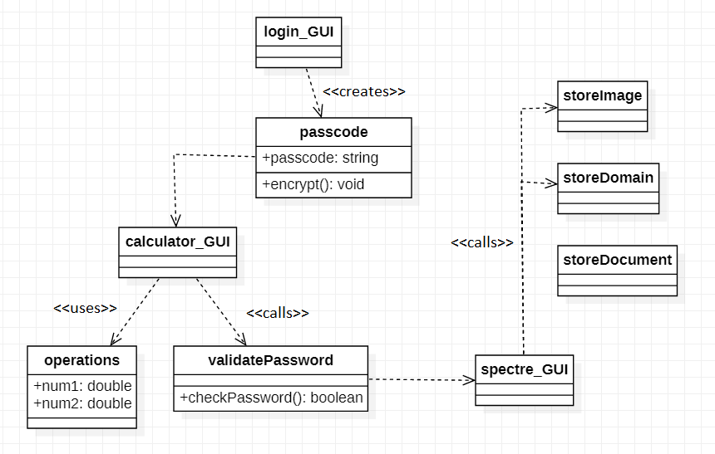
Design Class Diagram

Slide 22
YouTube Demo
Click Me!

Slide 23
Summary
Great introduction to agile app development and working in a team setting.
Despite development hurdles, we built a basic app that does what it needs to.

Slide 24

Q&A

